Slide 1

The Brain
GTHBY
Year 12 General Human Biology

Slide 2
Review
The function of the CNS is coordination and integration of sensory information (changes in the environment) with actions (responses).
Give an example of sensory information.
Give an example of a response.
How does the sensory information get to the CNS?

Slide 3
Review
How does the CNS send information to effectors (so that actions can be effected)?
Give an example of an autonomic sympathetic response.
Give an example of an autonomic parasympathetic response.
Give an example of a somatic motor response.

Slide 4
Learning Intentions
Structures and functions of the brain: cerebellum, cerebrum, brainstem and spinal cord

Slide 5
Success criteria
Label cerebellum, cerebrum, brainstem and spinal cord on an anatomical diagram
State the function of the cerebellum, cerebrum, brainstem and spinal cord

Slide 6
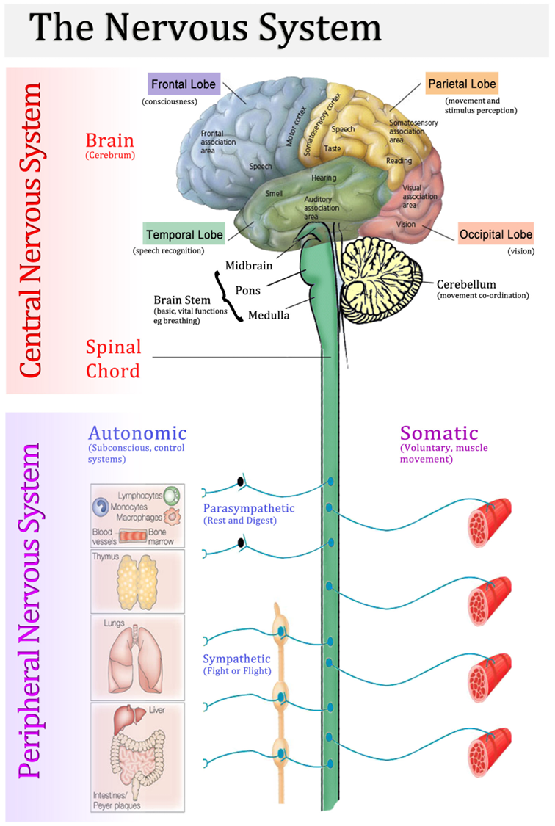

Slide 7
The brain and spinal cord
The brain is one of the largest and most complex organs in the human body.
It is made up of more than 100 billion nerves that communicate in trillions of connections called synapses.

Slide 8
The brain and spinal cord
The central nervous system is made up of many specialised areas that work together:
Cerebrum
Cerebellum
Brain Stem
Spinal Cord

Slide 9
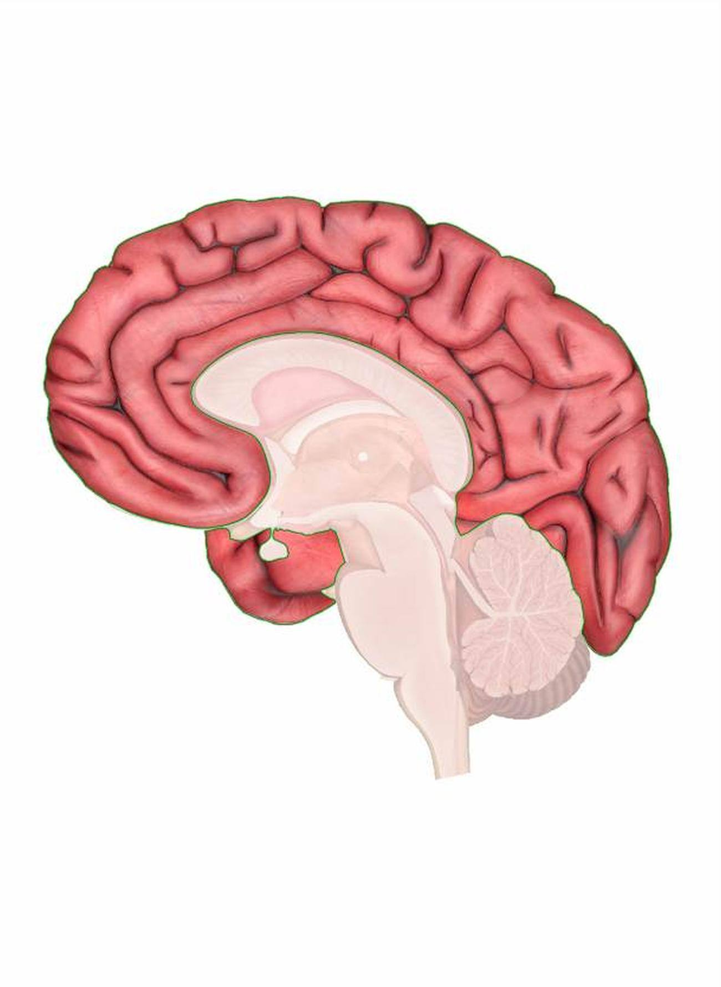
Cerebrum (forebrain)
The cerebrum is the uppermost and largest part of the brain.
The cerebrum is responsible for consciousness, speech, movement and stimulus reception, and vision.

Slide 10
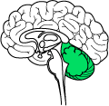
Cerebellum (hindbrain)
The cerebellum is at the base and the back of the brain. The cerebellum is responsible for coordination and balance.

Slide 11
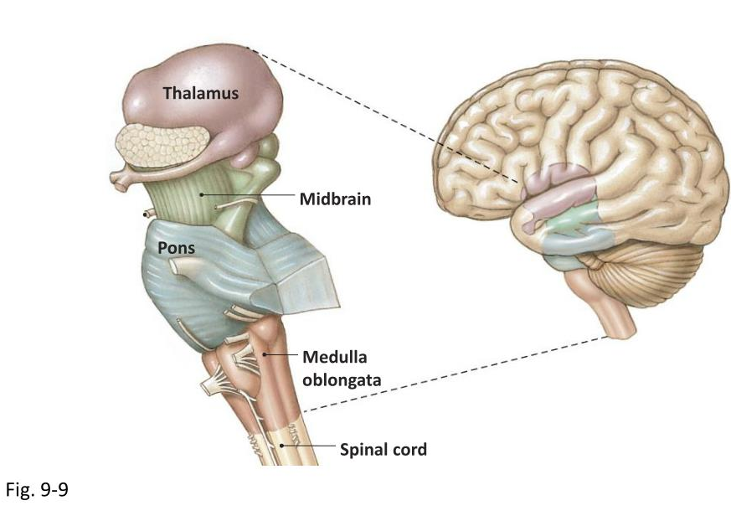
Brain stem (midbrain)
The brain stem is between the spinal cord and the rest of the brain. Basic functions like breathing and sleep are controlled here.

Slide 12
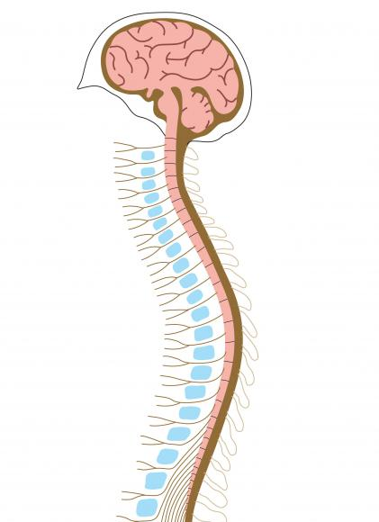
Spinal cord
The spinal cord is an extension of the brain stem. As well as connecting nerves to the brain, it is responsible for reflexes.

Slide 13
Success criteria
Label cerebellum, cerebrum, brainstem and spinal cord on an anatomical diagram
State the function of the cerebellum, cerebrum, brainstem and spinal cord

